Slide 1


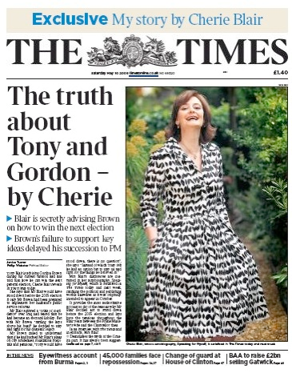
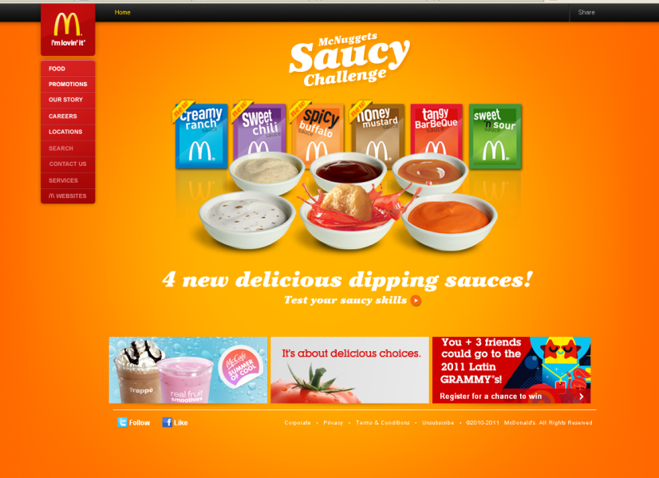
House Style

Slide 2
What is house style?
The colours, fonts (style, size and colour) and images that you use on a websites, presentations, magazines or books.
This gives your publication a professional look to it and people will connect that house style to a business or product.
Example: McDonalds – Red & Yellow used through out publications and the phrase “I’m loving it”.

Slide 3

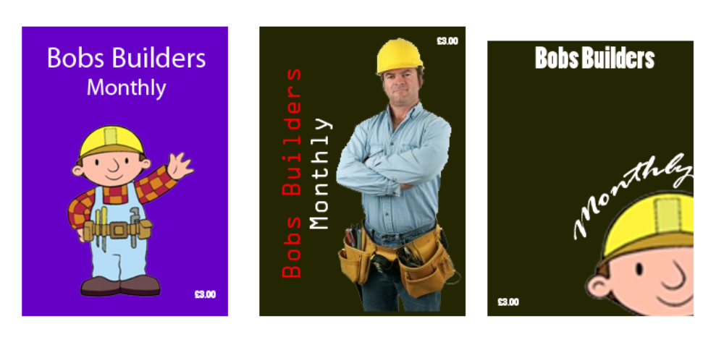
Spot the difference between GOOD and BAD house style

Slide 4
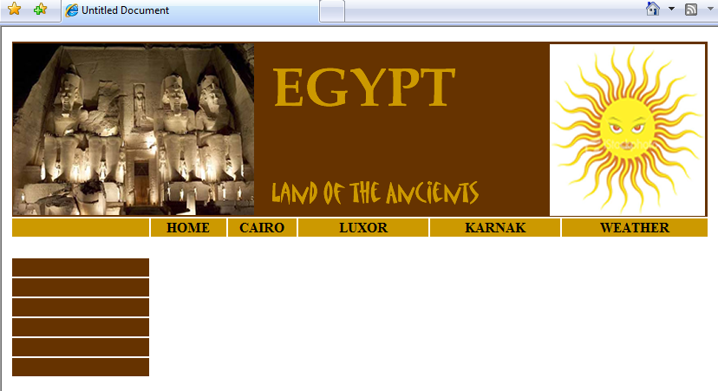
Example of GOOD house style

Slide 5
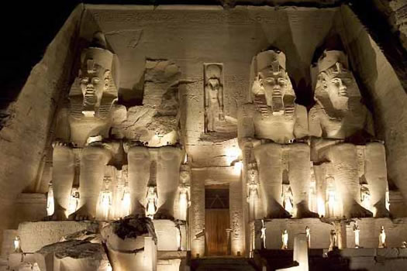

Representing this in Design
The colours that I will use are gold, white and brown. I am using these colours because the yellow represents the sun (it’s a very sunny country) brown represents the rocky mountains of the desert. I am using white for the background because it will contrast with the black text.
TEXT – I will use Book Antiqua and MATISSE for the Banner and on the hyperlinks, but Arial text for the bulk of the Text. This is because the first two are styled like ancient writing but Arial is a clear font good for blocks of text on a website
Images – these images will be part of my house style and appear on every page. The temple represents the ancient world of Egypt and the sun the fact that it is a hot country

Slide 6
TASK
Complete a document like the previous slide which shows what colours, fonts etc you will use
EXPLAIN why you are using them – why will it attract an audience
At the end of the lesson place this document in your teachers post box.

